Slide 1
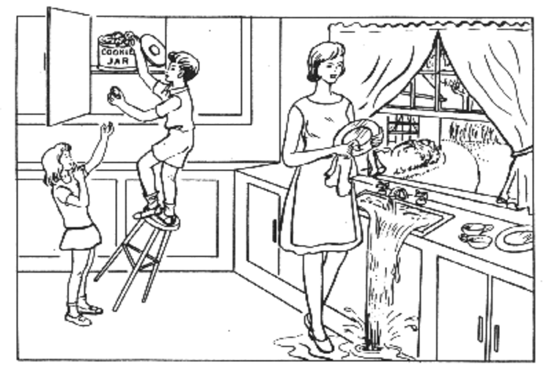
Cookie theft analysis

Slide 2
Facial landmarks
Using mediapipe
Parameters:
minDetectionConfidence=0.5
minTrackConfidence=0.5
refine_landmarks=True
N landmark samples = N video frames with a face
Start and end video extracted from tstart= beep sound, tend = min(task duration or video duration)
Lf pass filter 30 Hz (240 fps), downsample factor 4 (60hz)

Slide 3
Audio
Mel parameters:
n_fft = 512 # time window size for FFT
n_mels = 128 # number of mel bands
Audio Fps 8000hz from 41K
hop_length = 160 # number samples hop
VAD parameters:
frame_duration = 10 # ms

Slide 4
Dataset (audio, face landmark, demographic)
dataset_new[sbj_id] = {}
dataset_new[sbj_id]["ts"] = dataset[sbj_id]["ts"]
dataset_new[sbj_id]["frame_ix"] = dataset[sbj_id]["frame_ix"]
dataset_new[sbj_id]["ts_Fs"] = my_clip.fps
dataset_new[sbj_id]["beh"] = dataset[sbj_id]["beh"] % demographic, clinical scale
dataset_new[sbj_id]['S_dB_Fs'] = sample_rate
dataset_new[sbj_id]['S_dB_duration'] = duration
dataset_new[sbj_id]['S_dB'] = S_dB
dataset_new[sbj_id]['S_dB_times'] = S_dB_times
dataset_new[sbj_id]['vad_bool'] = vad_bool
dataset_new[sbj_id]['vad_times'] = vad_times
dataset_new[sbj_id]['vad_times_frame_duration'] = frame_duration

Slide 5
Exclude subjects
out_files = {"10072_2018_06_27" : "face cropped",
"10079_2018_05_30": "not doing task",
"10029_2018_08_01": "not much talking",
'10049_2019_12_23' : "face cropped",
"10120_2019_01_11": "Doesn't talk much",
"10120_2019_10_12": "no talking",
"10120_2020_01_10": "no talking",
"10122_2019_01_11": "little girl just words",
"10130_2019_01_12": "not much talking",
"10130_2020_01_11": "not much talking",
"10207_2018_07_12": "face cropped",
"10208_2018_07_16" : "child moving all over, occluding with hands",
"10209_2018_07_16": "child not talking",
"10272_2019_01_10": "not looking",
"10275_2019_01_11": "kid moving",
"10276_2019_01_11" : "child moving all over, occluding with hands",
"10282_2019_01_12":"no talking",
"10323_2019_11_18":"no talking",
}

Slide 6
Dataset (after filtering subjects)
Groups, n subj, avg session length, std :
'AT': 1, 109 sec avg
'Ataxia': 102, 53 sec avg, std 42
'Control' : 43, 51 sec avg, std 32
'FND': 1, 13 sec avg
'MG': 13, 43 sec avg, std 27
'Other': 22, 53 sec avg, std 59
'PD': 53, 64 sec avg, std 53
'Unknown': 4, 60sec avg, std 38

Slide 7
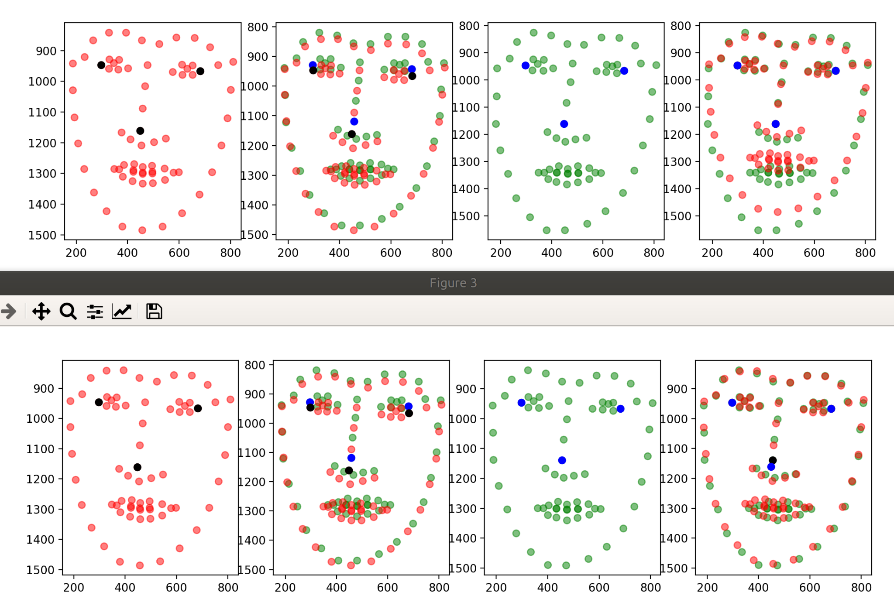
Face pose alignment
Affine 3 pnts
Affine 2 pnts (eye sides)

Slide 8
DL, round 1(split by subj_sess ID)
Parameters:
win_len = 2
hop = 1
vad_min = .5
g1, g0 = 'Ataxia', 'Control'
batch_train = 8
Data split with subject_Session ID
Data windowed accepted if avg speech boolean is .5
Train = 80%, 20% val
Win length data training:
Ataxia, window samples = 2731
CTR, window samples = 1273
PD, window samples = 1404
Win length data val:
Ataxia, window samples = 441
CTR, window samples = 327
PD, window samples = 565
Val ratios data imbalance Ataxia/CTR = .57, PD/CTR = .63

Slide 9
DL results, round 1
Ataxia vs Ctr
Pose:
Acc 68
Audio:
epoch 37 Train loss: 0.068 Train acc: 98.258 Train f1: 0.984 Val loss:0.315 Val acc: 89.156 Val f1: 0.891

Slide 10
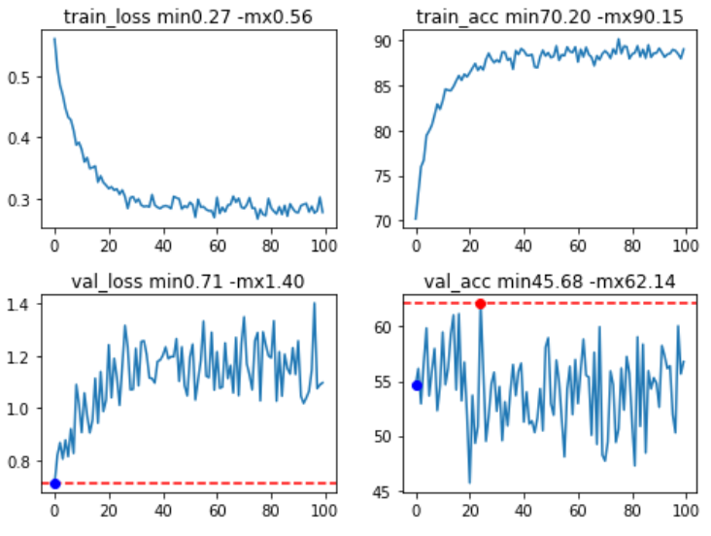
DL results, round 2 split by subj
Ataxia vs Ctr
Pose:
mask_y_len=25
mask_x_len=10
epoch 54 Train loss: 0.215 Train acc: 92.149 Train f1: 0.922 Val loss:1.124 Val acc: 63.671 Val f1: 0.632
Audio:
epoch 41 Train loss: 0.050 Train acc: 98.843 Train f1: 0.989 Val loss:0.501 Val acc: 84.075 Val f1: 0.834

Slide 11
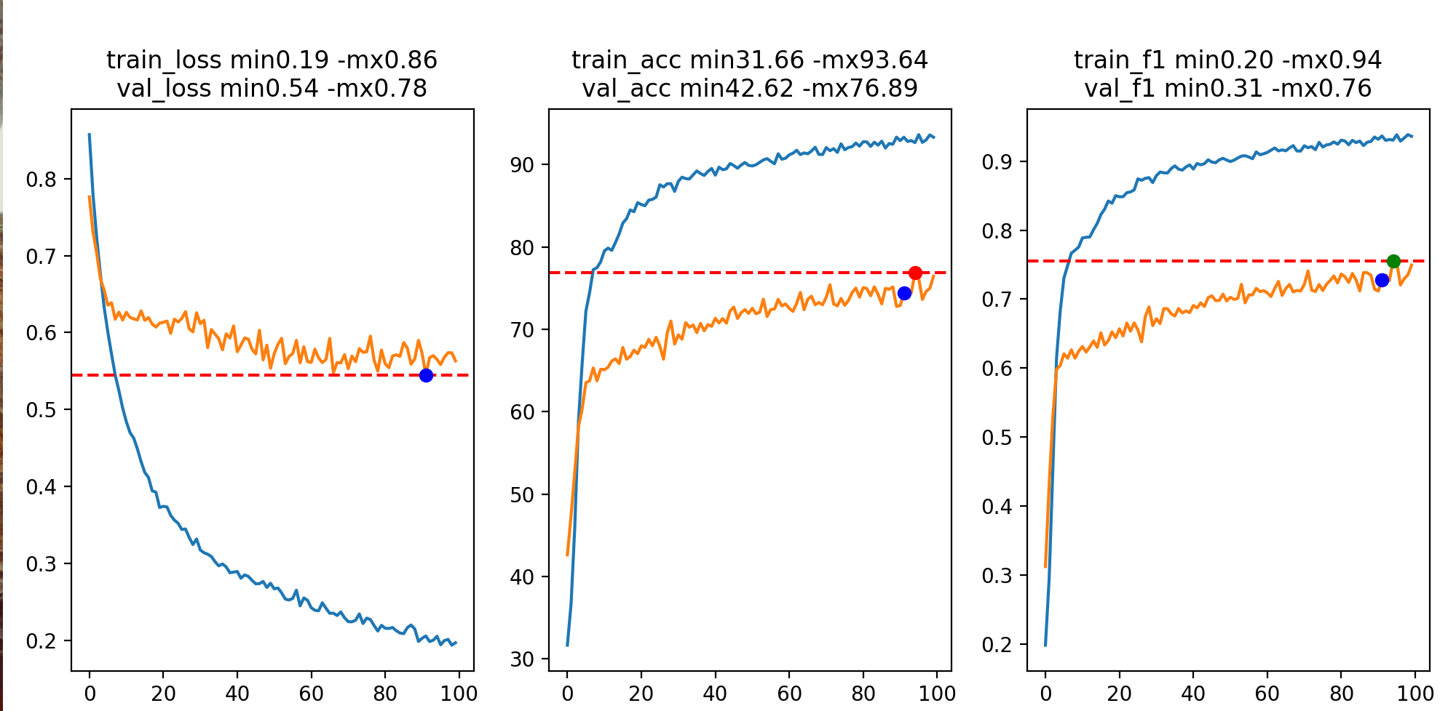
model_name = inception
data_input = multi
win_len = 100 hop = 50
optim = Adam lr=1e-06
mask_y_len = 20 mask_x_len = 1
vad_min = 0.5 g1, g0 = Ataxia Control
batch_train = 8 batch_val = 8
n_epochs = 100 split = individ

Slide 12
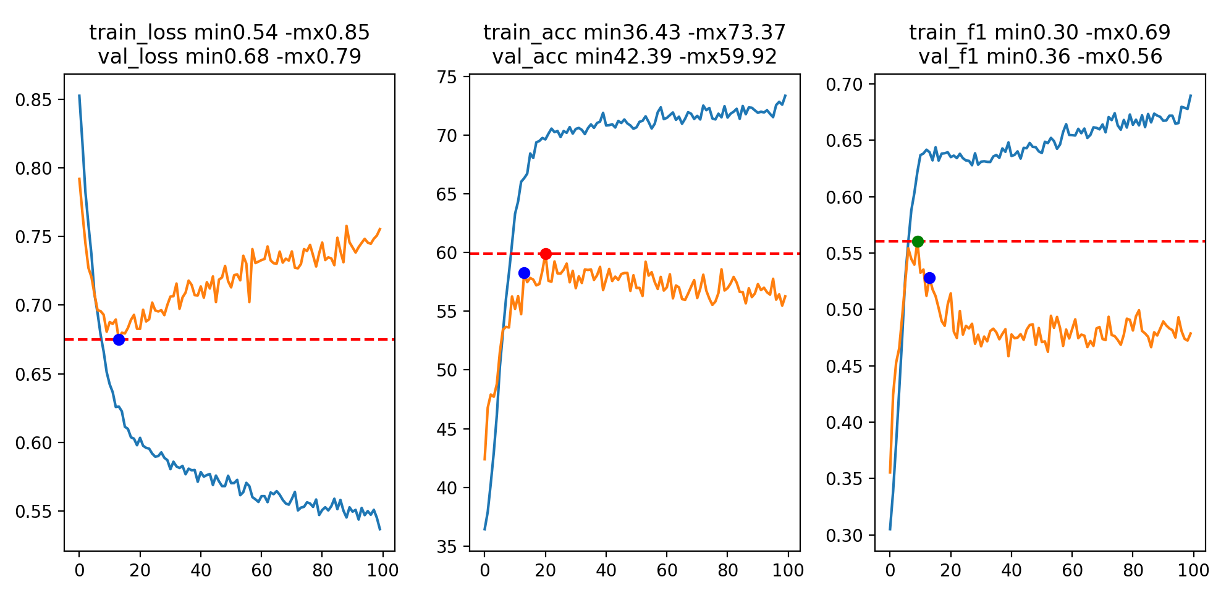
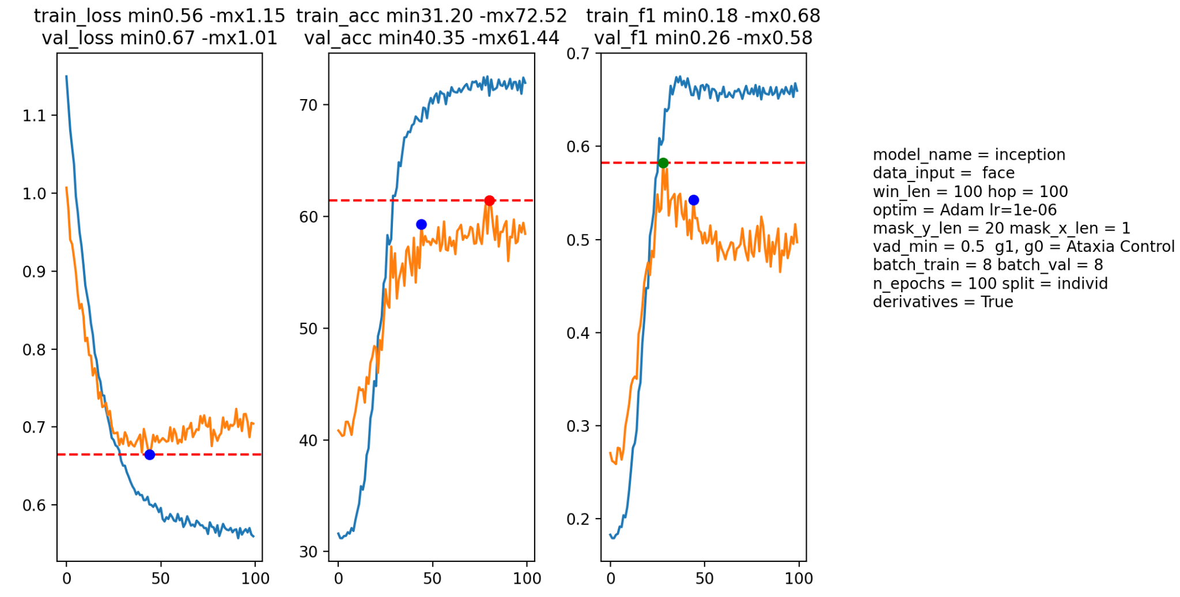
Pose
model_name = inception
data_input = face
win_len = 100 hop = 50
optim = Adam lr=1e-06
mask_y_len = 10 mask_x_len = 1
vad_min = 0.5 g1, g0 = Ataxia Control
batch_train = 8 batch_val = 8
n_epochs = 100 split = individ
Finished Training in 14.555384194850921
Maxx val acc: 60.588235294117645

Slide 13
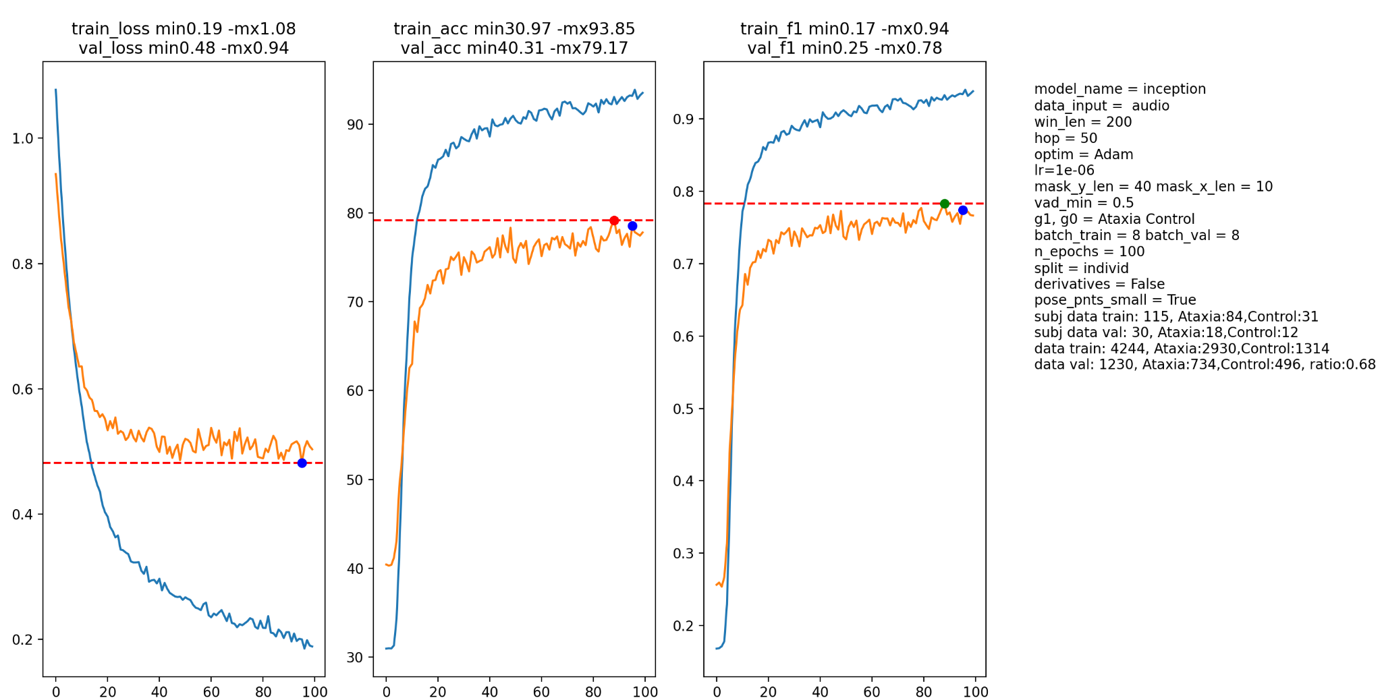
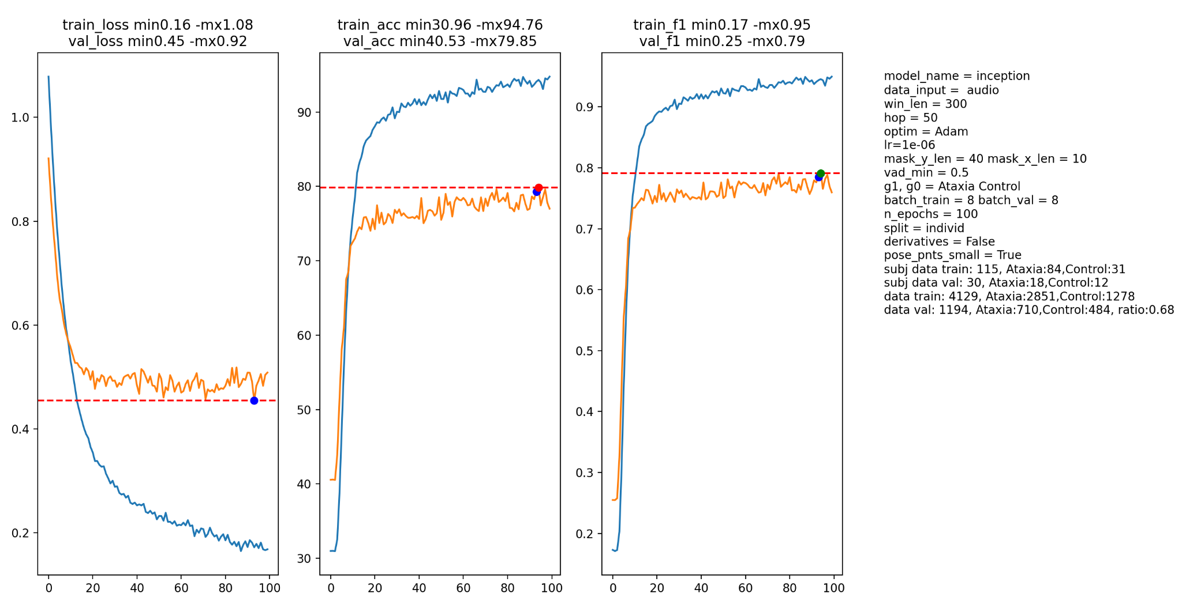
Audio inception

Slide 14
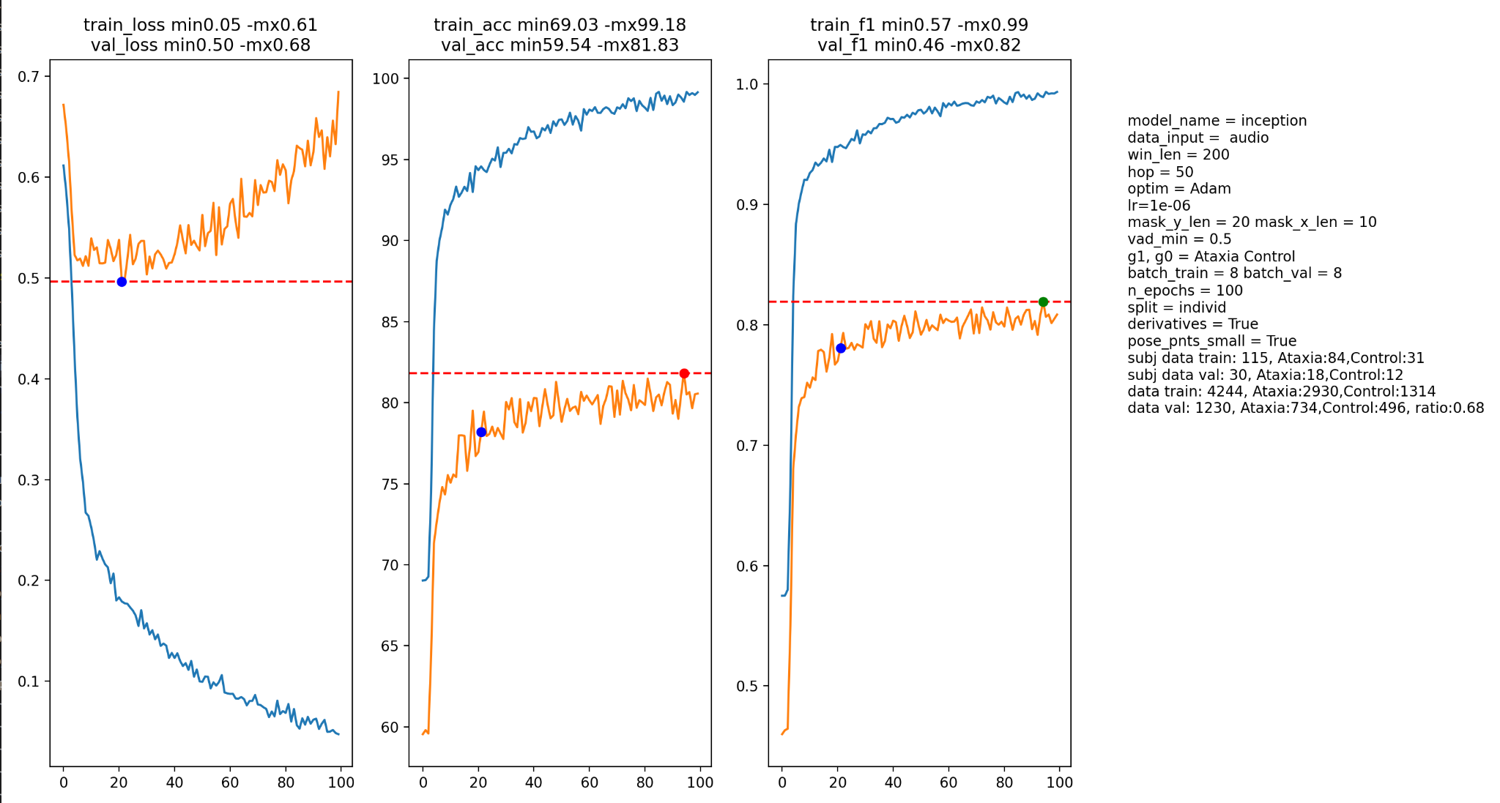
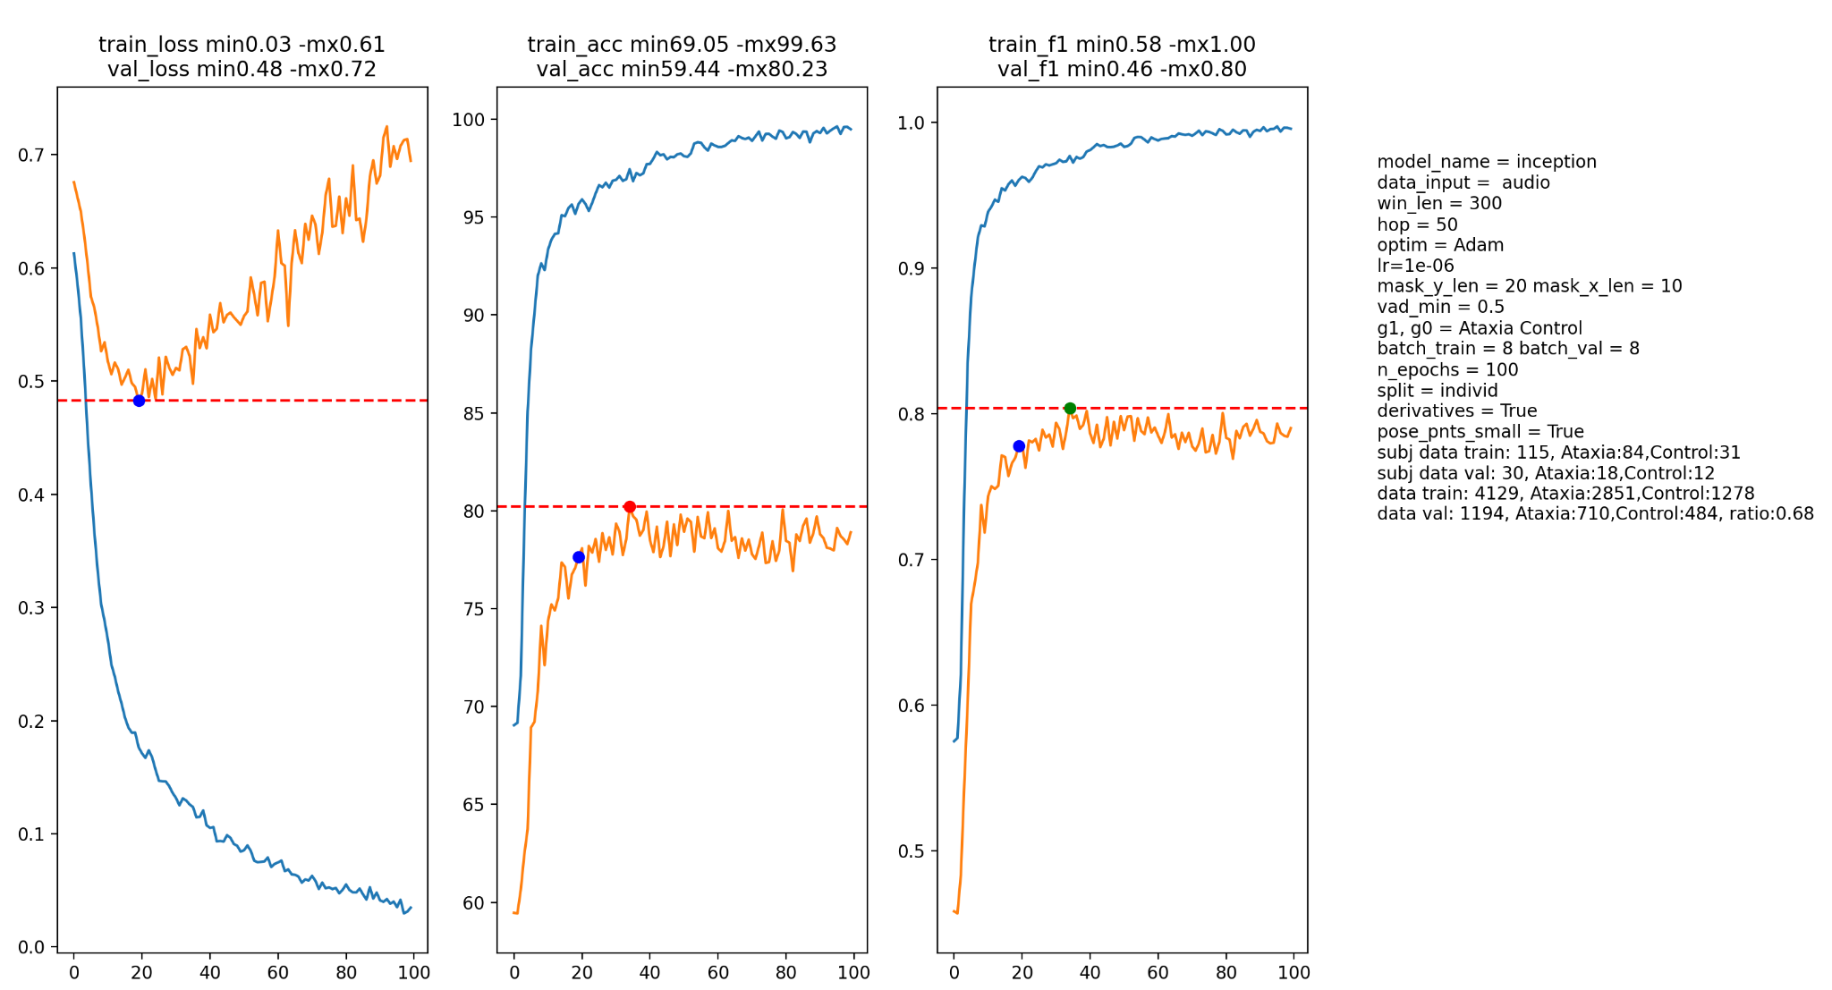
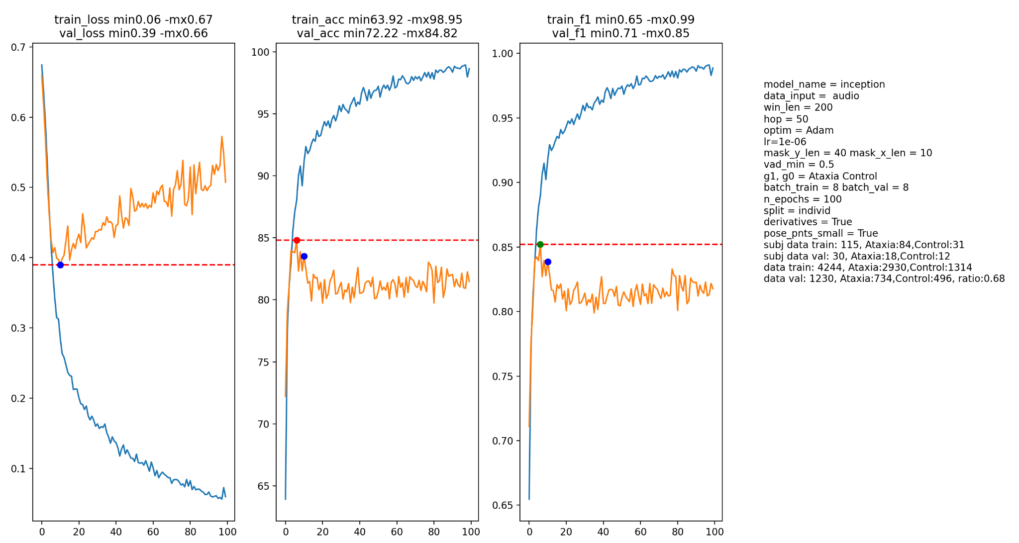
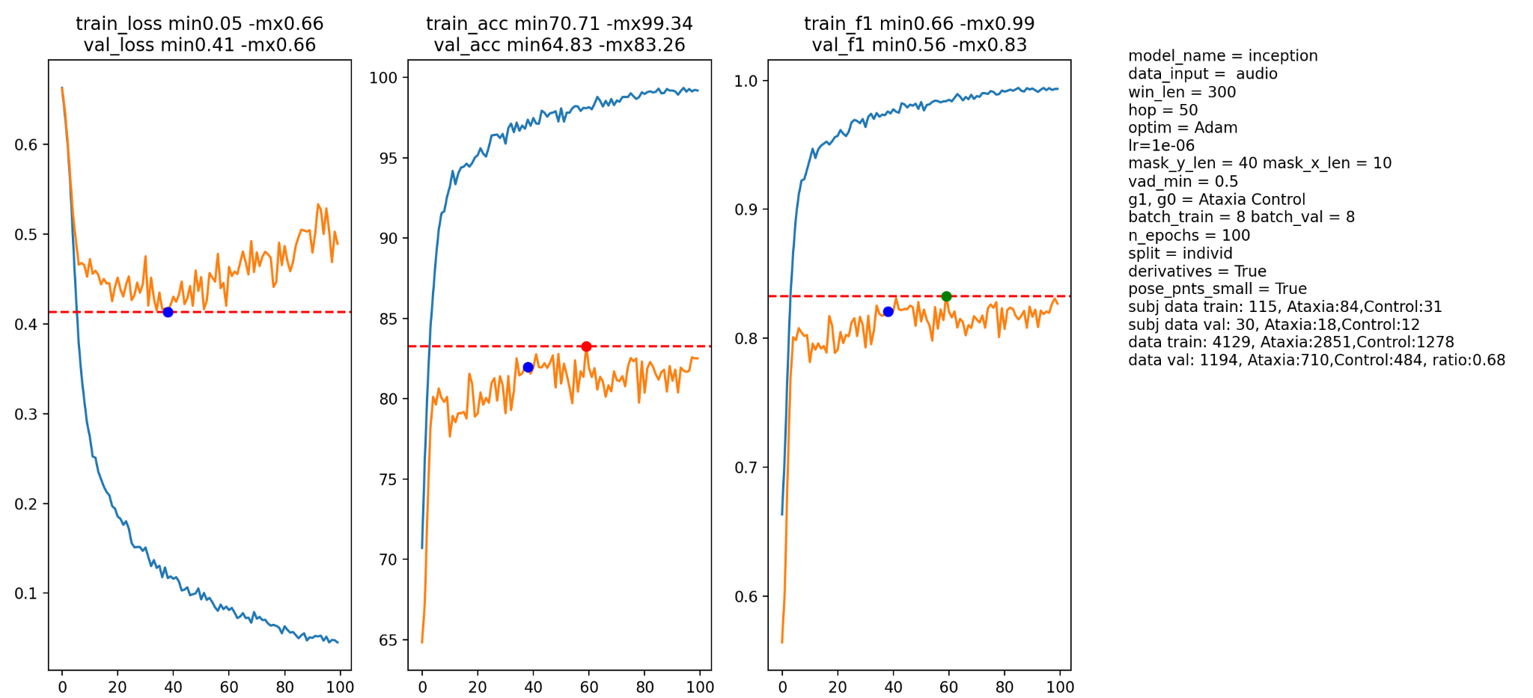
Audio inception deriv

Slide 15
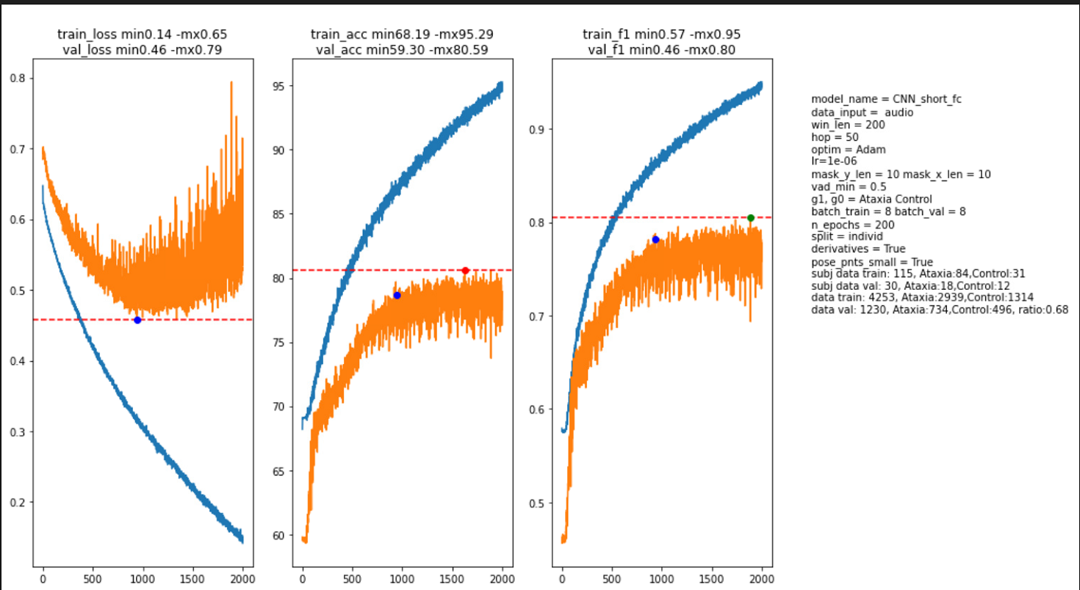
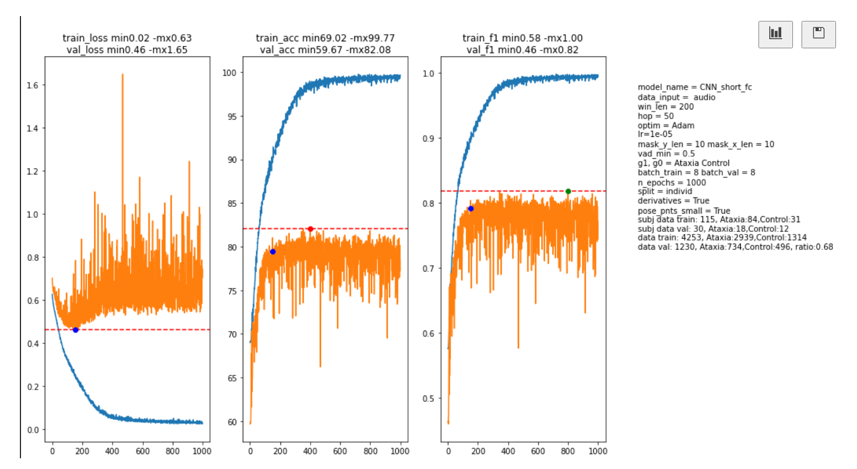

Slide 16
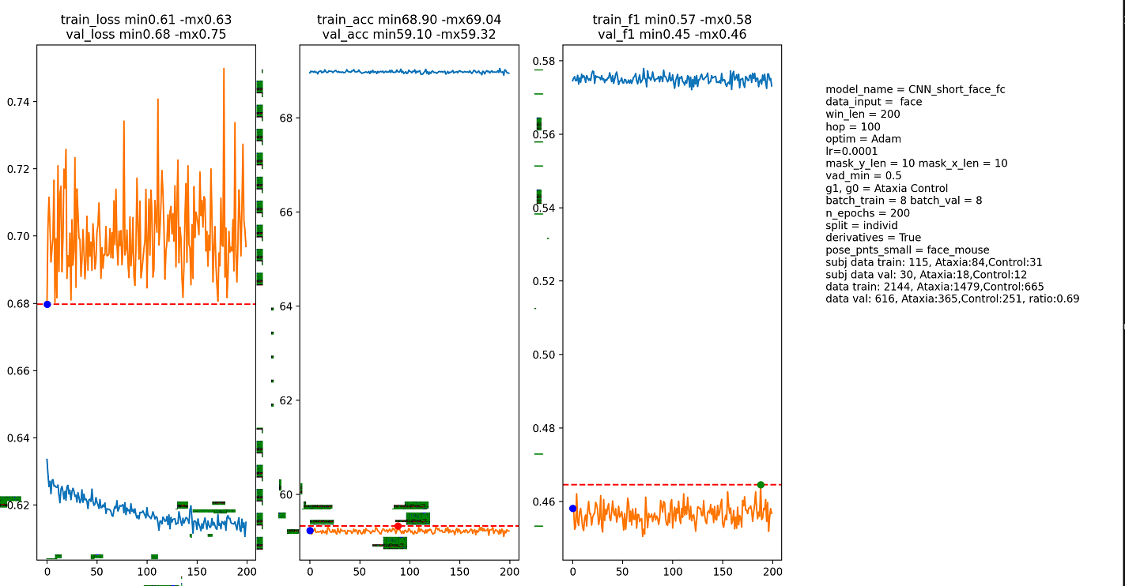
Face (mose eyes pnts)

Slide 17
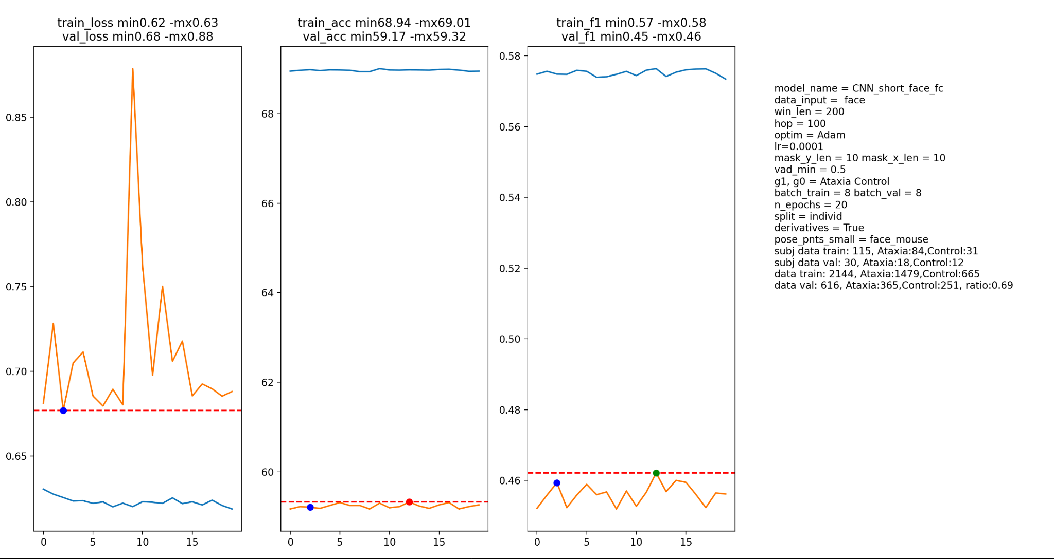
Face (mose eyes pnts)
2D conv no reg

Slide 18
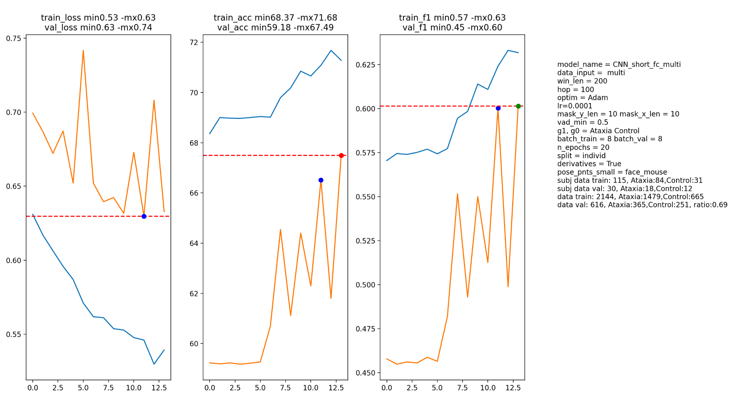
2d CNN pose + audio

Slide 19
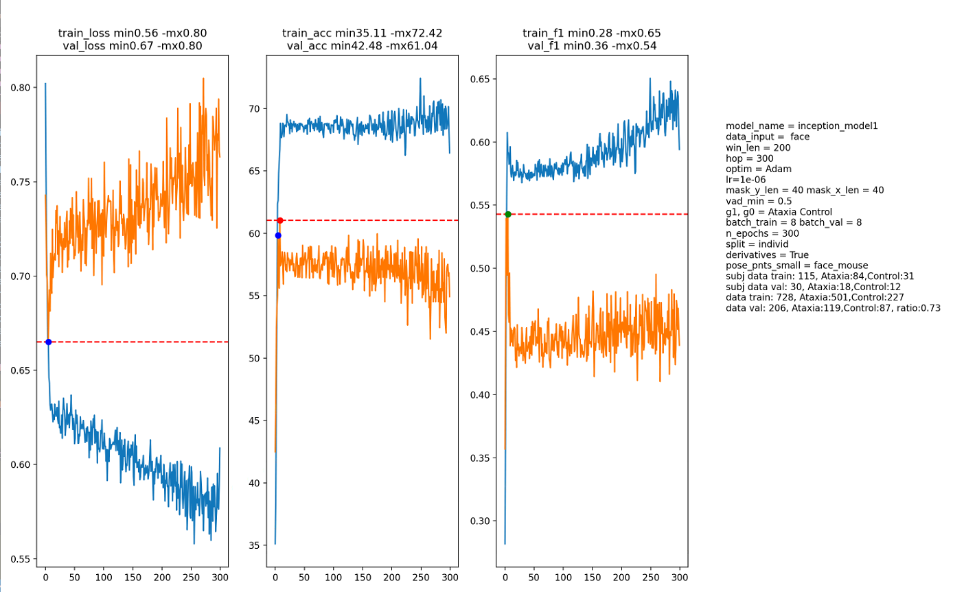
Face inception 1blk reg

Slide 20
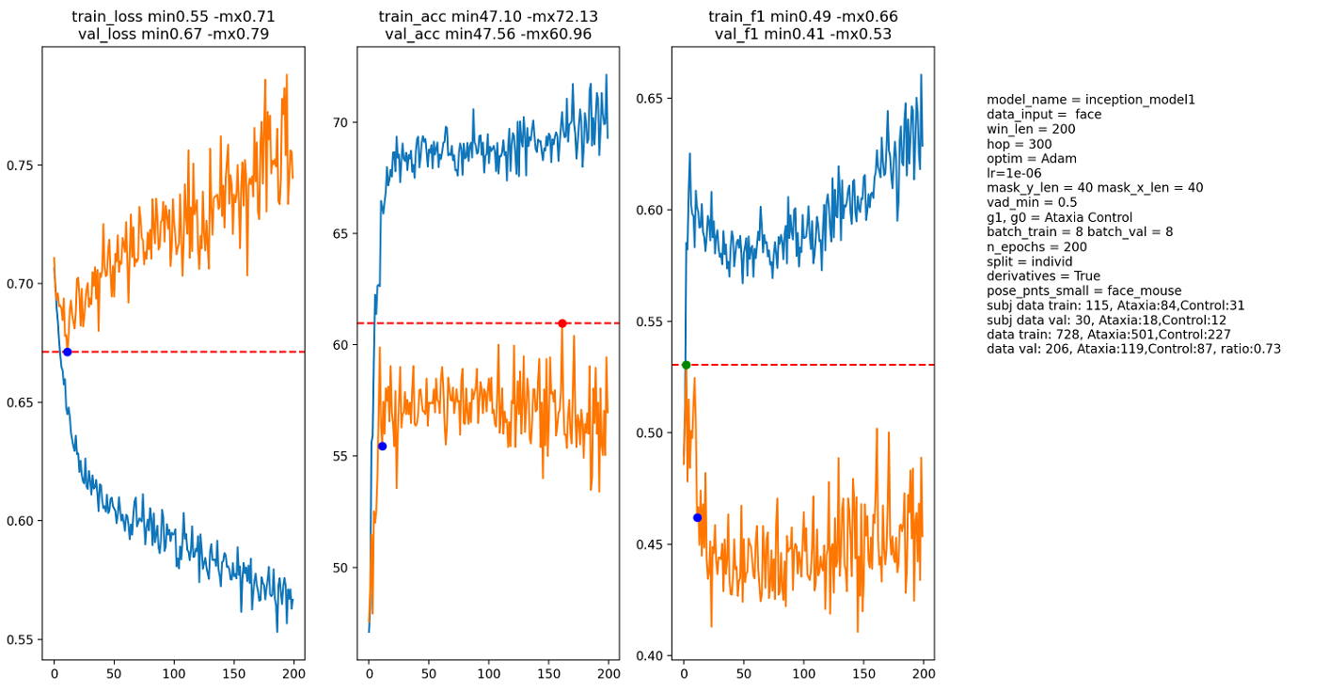
Face inception 1blk reg

Slide 21
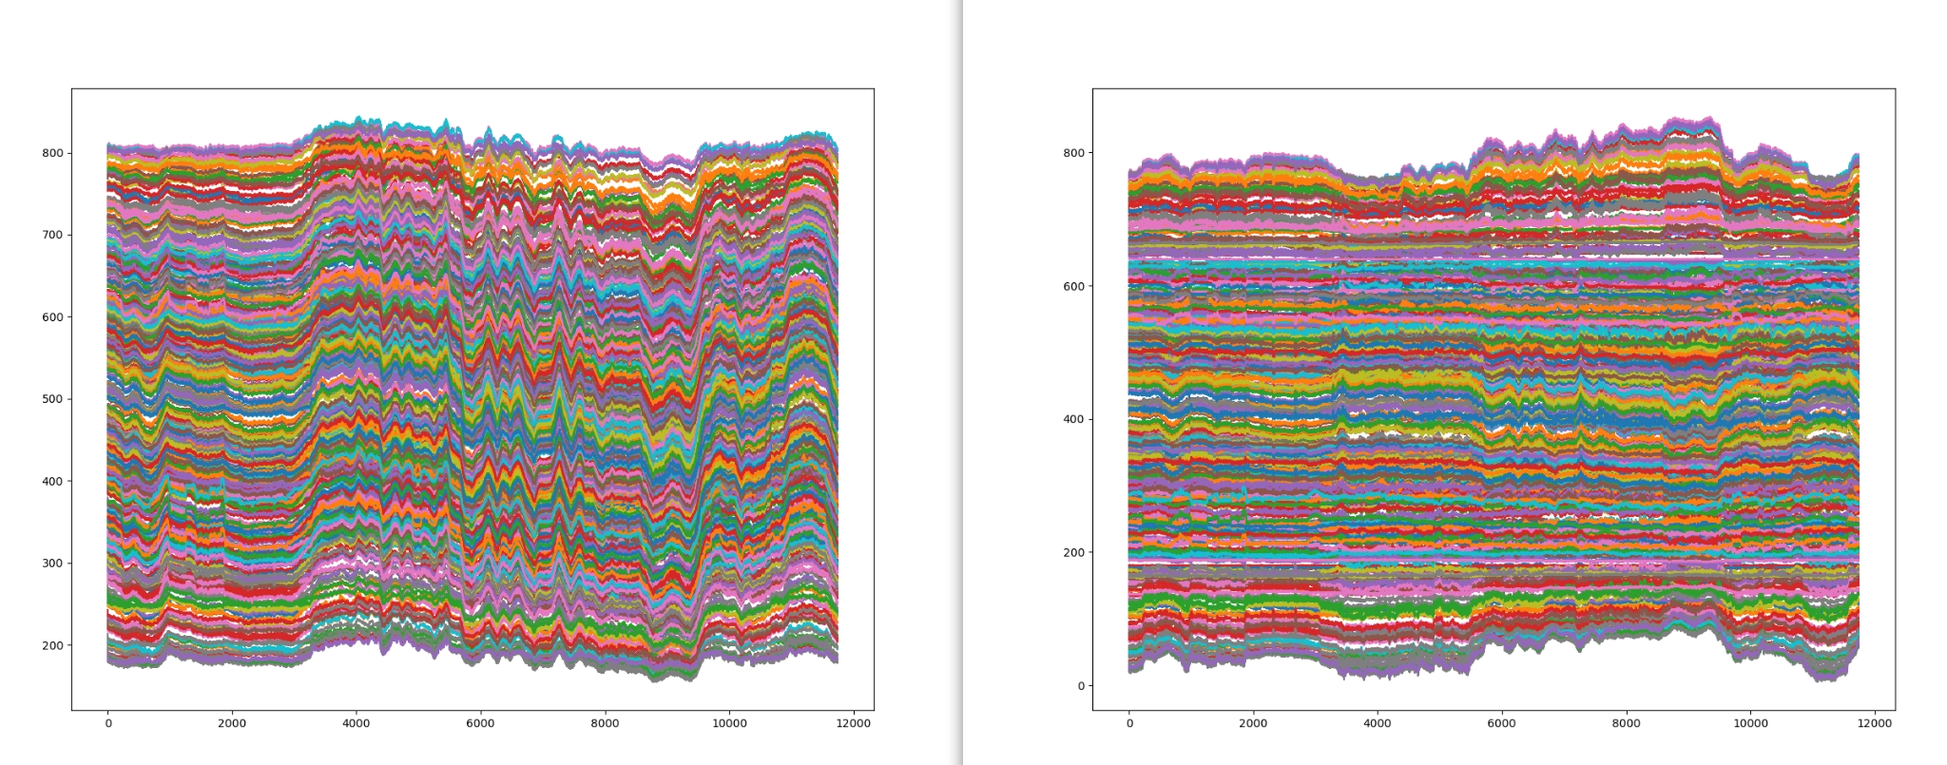
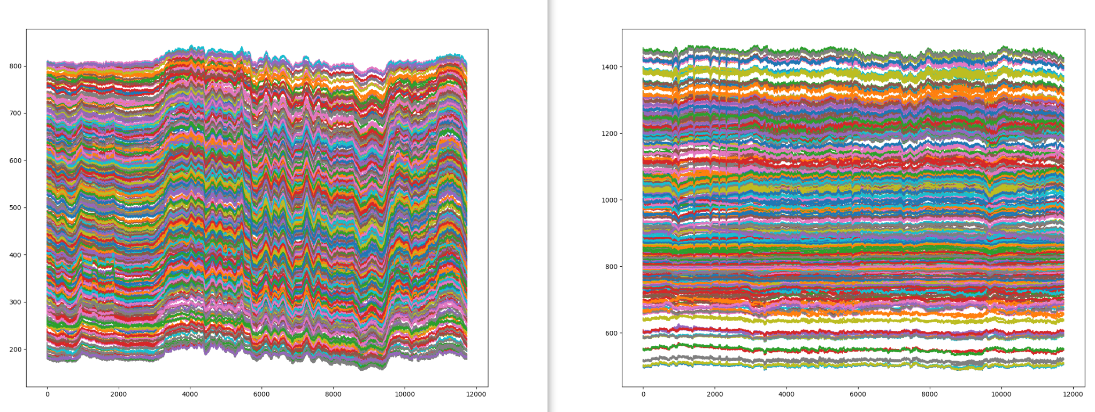
Before and after alignment to eye corners (x, y axis)

Slide 22
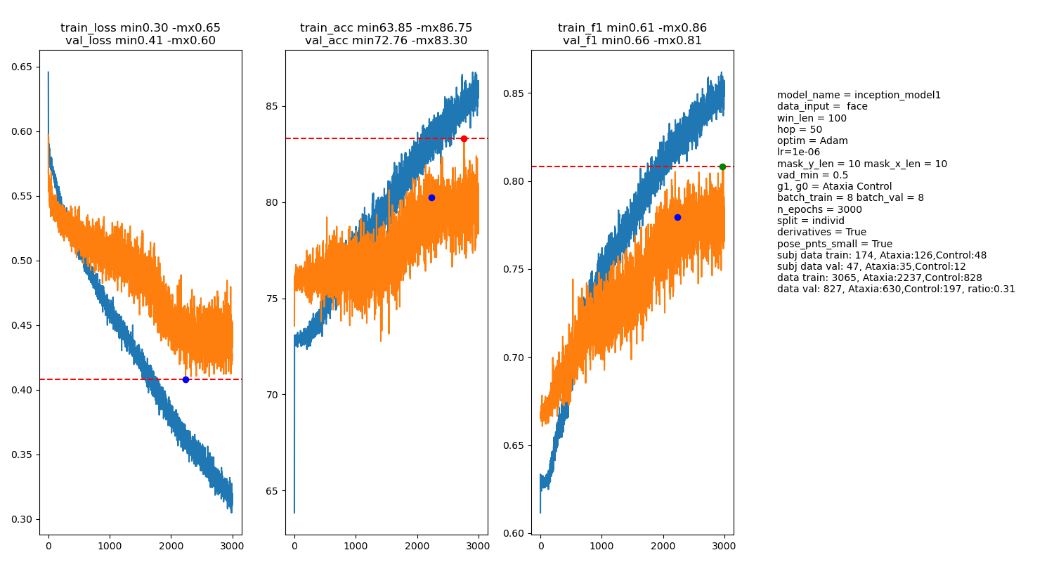
Go La Me Ataxia vs Ctr
74 face landmarks, inception 1 (inception with one module)

Slide 23
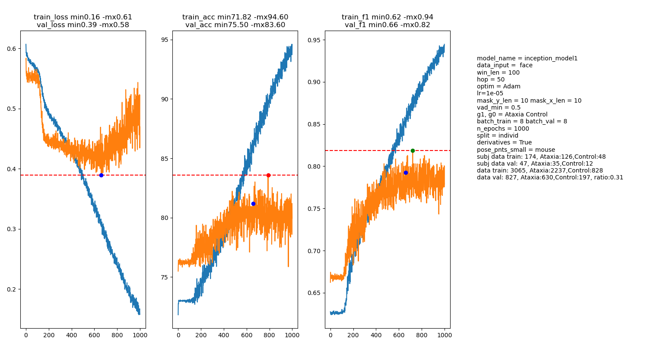
Go La Me Ataxia vs Ctr
Mouse landmarks, inception 1 (inception with one module)

Slide 24
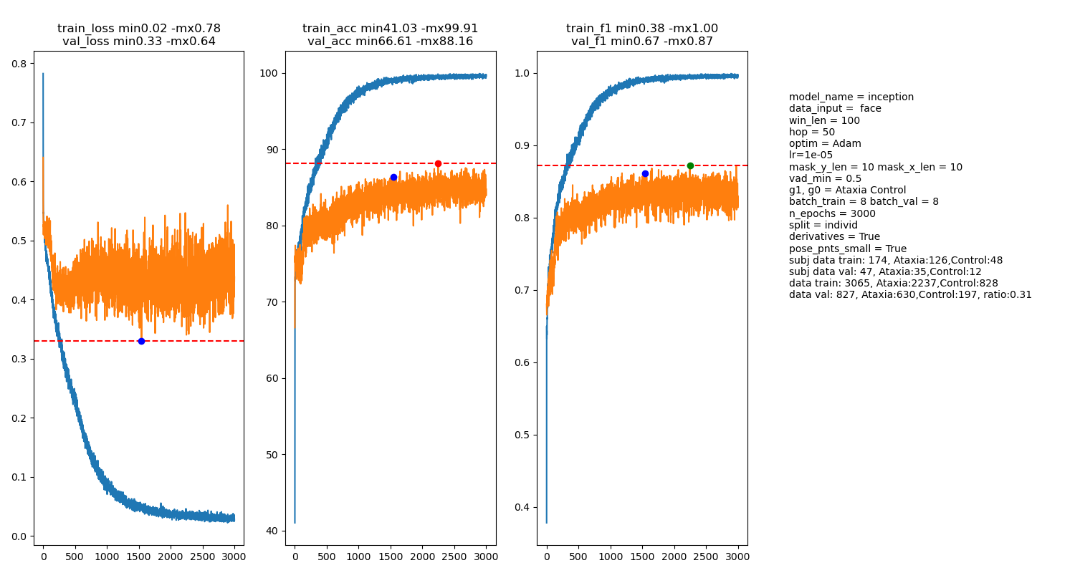
Go La Me Ataxia vs Ctr
74 face landmarks, inception full model

Slide 25
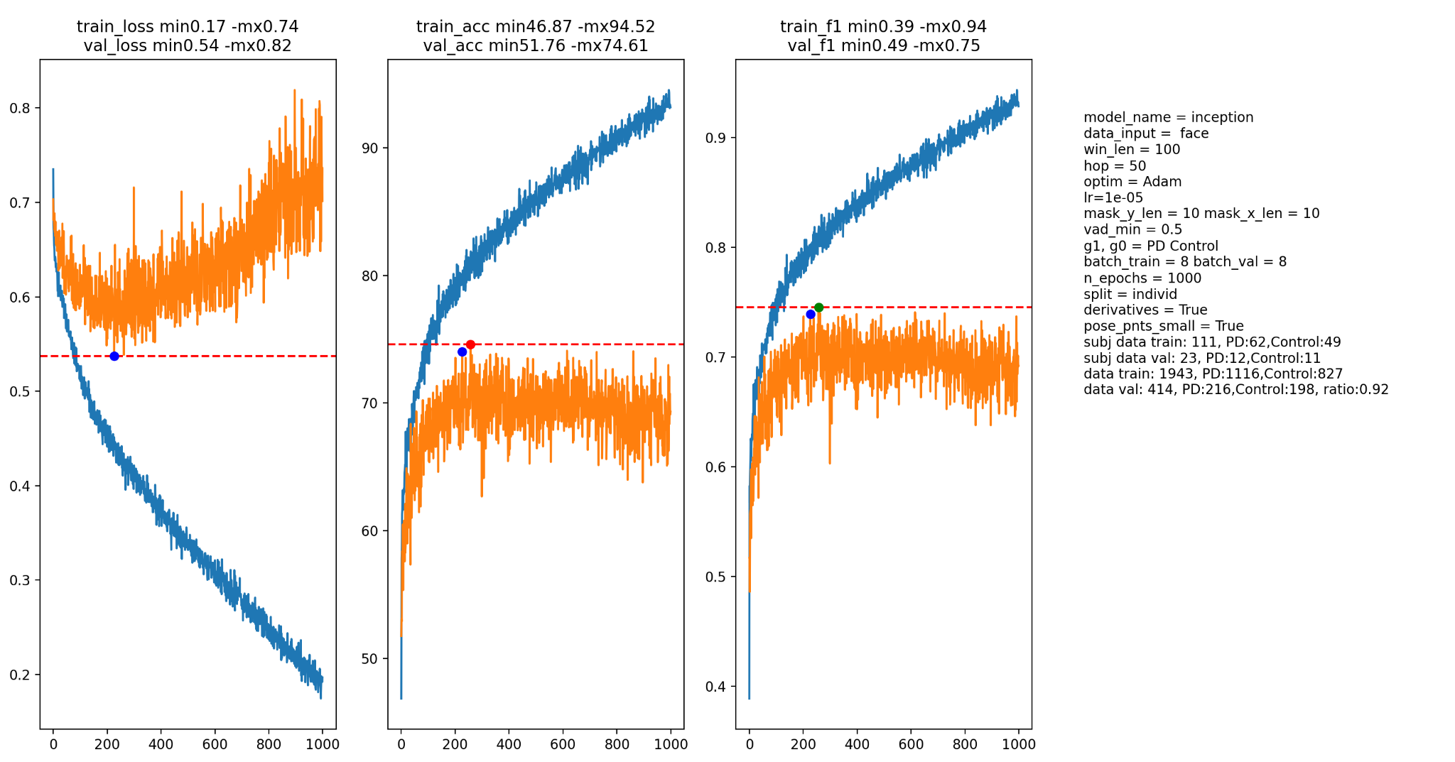
Go La Me PD vs Ctr
74 face landmarks, inception 1 (inception with one module)

Slide 26
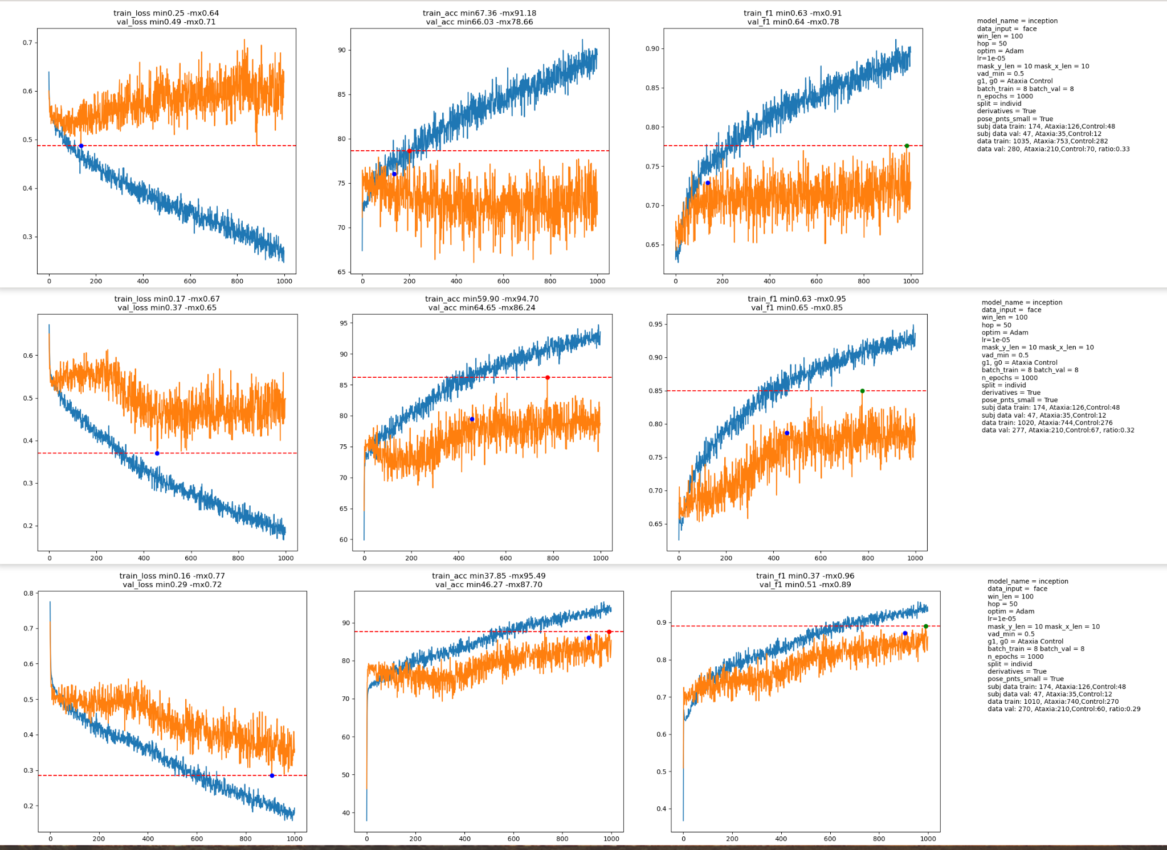
Go La Me per task Ataxia vs Ctr
Go
La
Me
74 face landmarks, inception

Slide 27
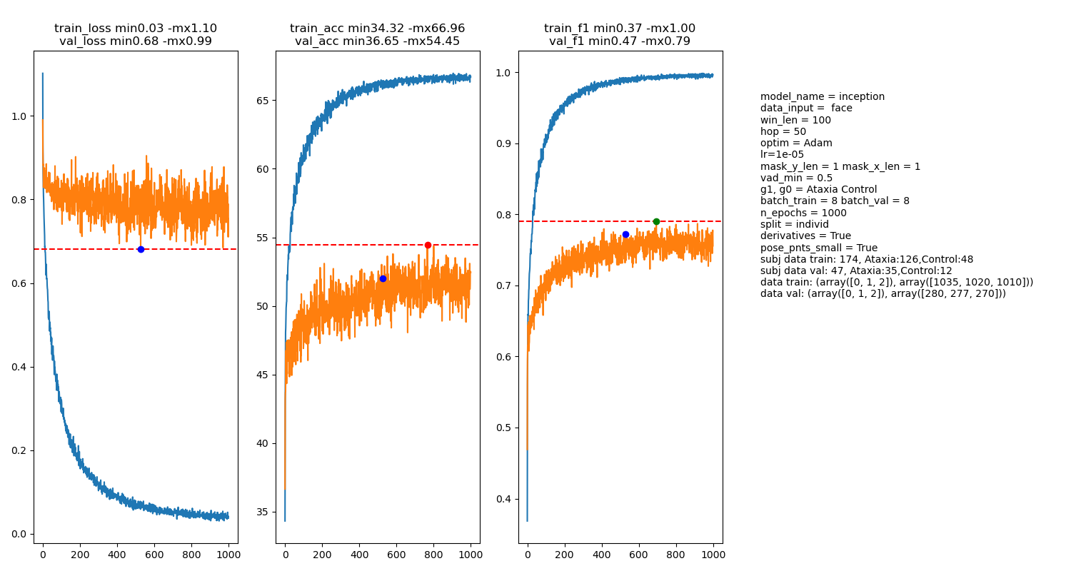
Tasks Go La Me classification
74 face landmarks, inception

Slide 28
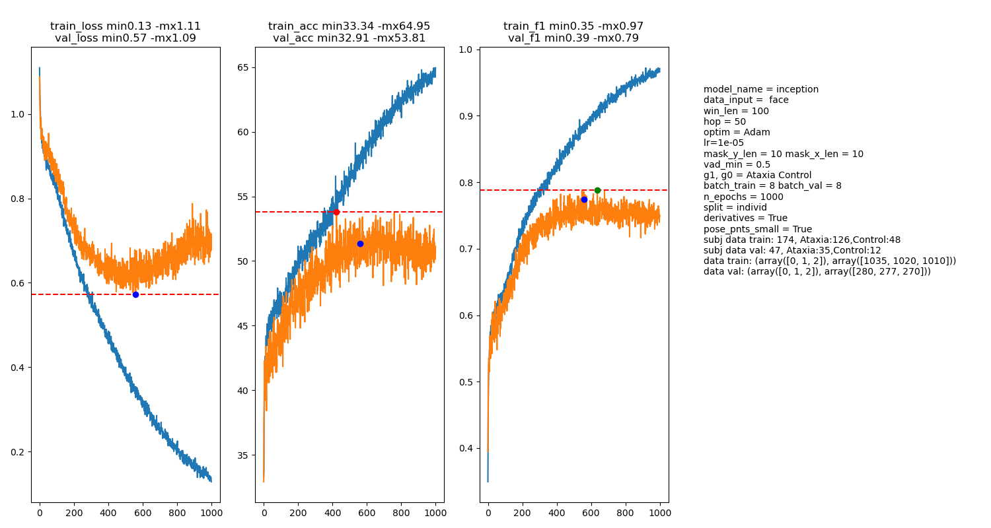
Tasks Go La Me classification
X, y 10 samples masking
74 face landmarks, inception

Slide 29
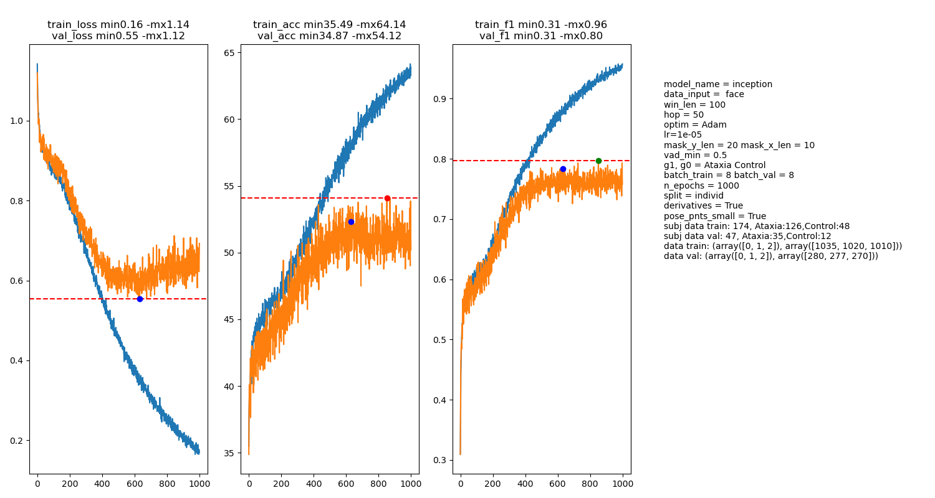
Tasks Go La Me classification
X 20, y 10 samples masking
74 face landmarks, inception

Slide 30
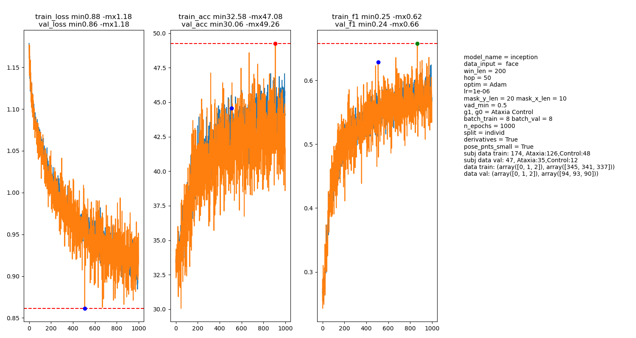
Tasks Go La Me classification
Learning rate 10e-7
74 face landmarks, inception

Slide 31
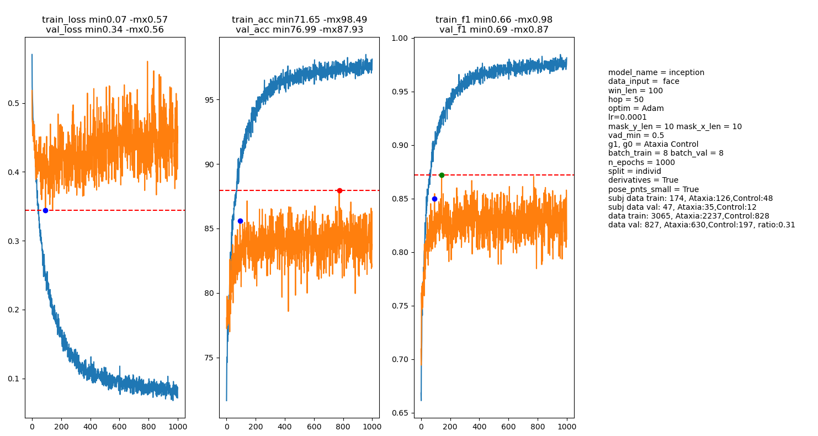
Transfer learning task class to AT vs ctr, gradient all layers
74 face landmarks, inception

Slide 32
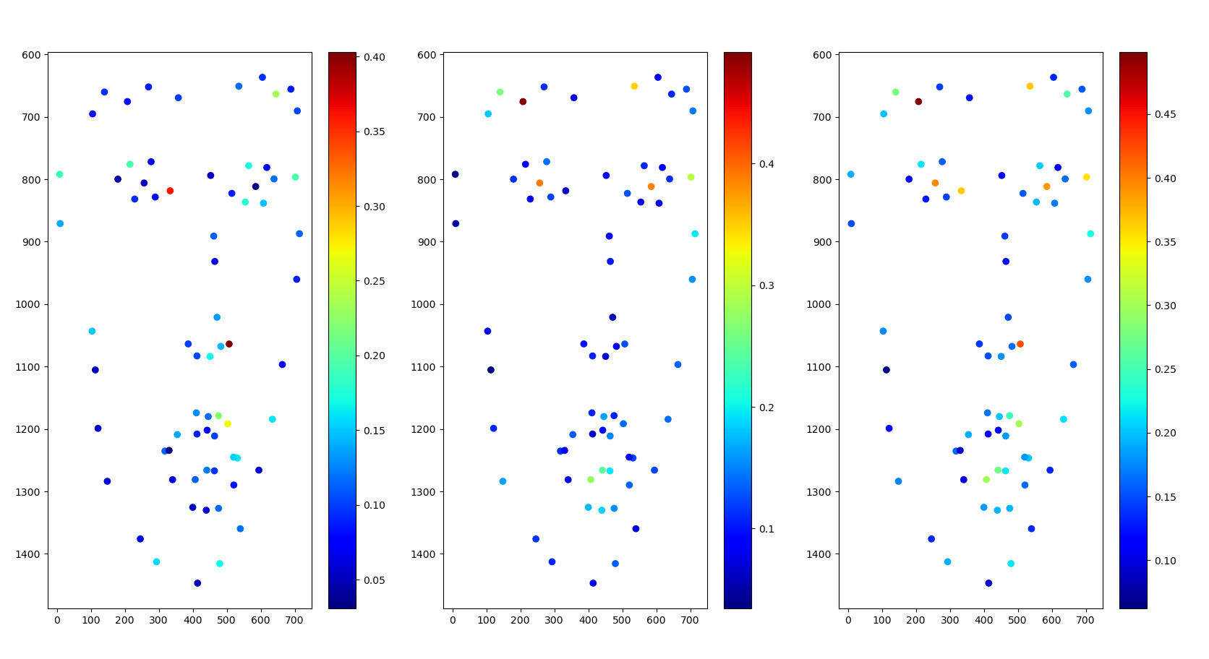
Saliency transfer learning Ataxia ctr classification
74 face landmarks, inception

Slide 33
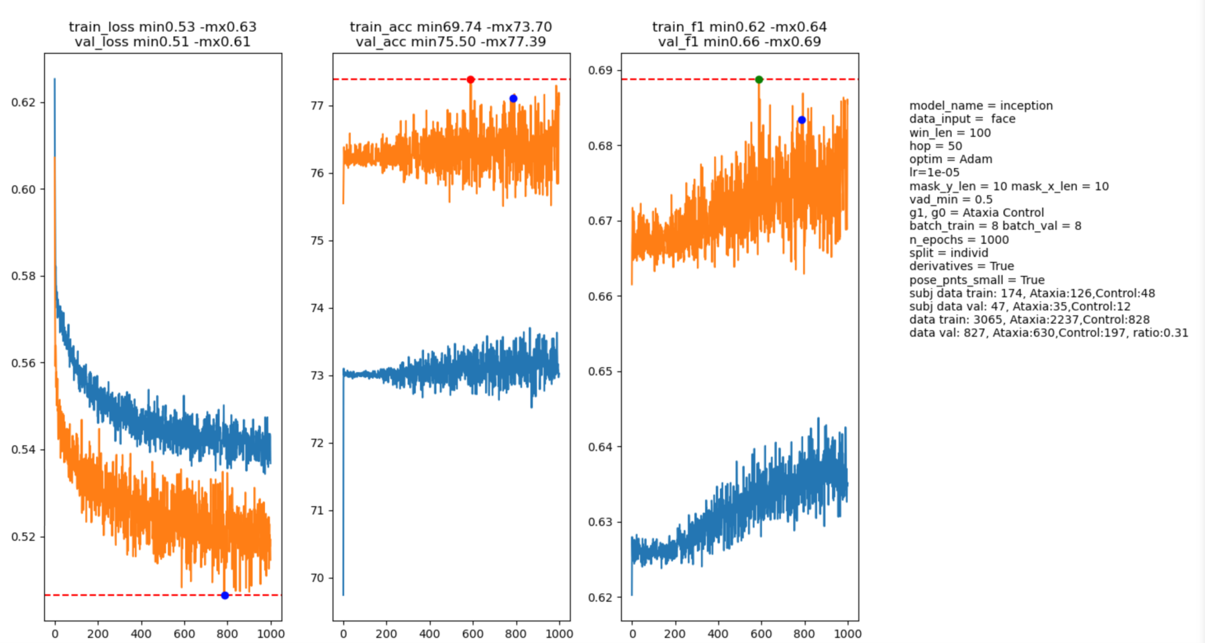
Transfer learning task class to AT vs ctr, frozen weights but last layer
74 face landmarks, inception

